Slide 1

AP1201 Chapter 8
Mechanical Waves (Chapter 15 in textbook)

Slide 2
Goals
To study the properties and varieties of mechanical waves
To relate the speed, frequency, and wavelength of periodic waves
To interpret periodic waves mathematically
To calculate the speed of a wave on a string
To calculate the energy of mechanical waves
To understand the interference of mechanical waves
To analyze standing waves on a string
To investigate the sound produced by stringed instruments

Slide 3
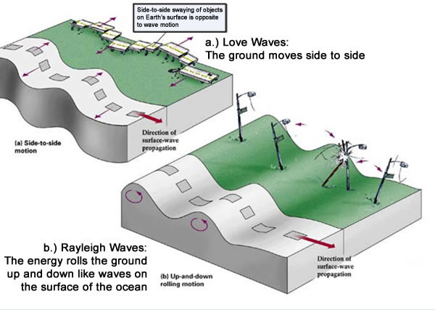
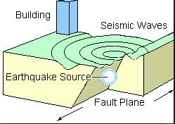
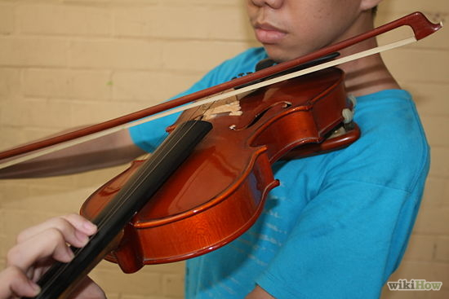
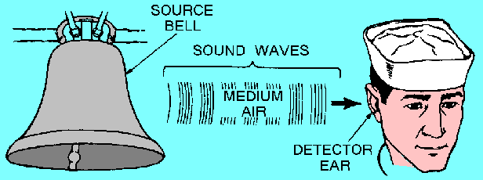
Introduction
Examples of waves
Earthquake waves carry enormous power as they travel through the earth.
Other types of mechanical waves, such as sound waves or the vibration of the strings of a violin,
Overlapping waves interfere, which helps us understand musical instruments.

Slide 4

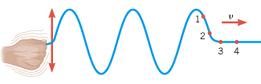
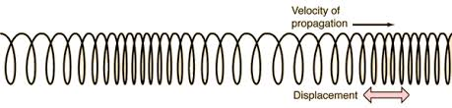
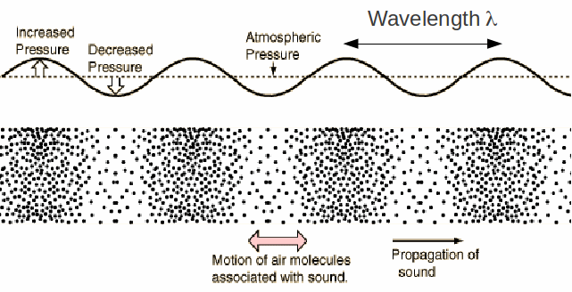
Transverse and longitudinal waves
Figure below illustrates transverse waves and longitudinal waves.
Video
Transverse: motion of particle is perpendicular to wave propagation direction
Longitudinal: motion of particle is parallel to wave propagation

Slide 5
Mechanical wave
A mechanical wave is a disturbance (pattern) traveling through a medium, involving the motion of particles of the medium
Create a disturbance using a hammer
The disturbance pattern remains unchanged but move in the medium with the speed of the wave

Slide 6
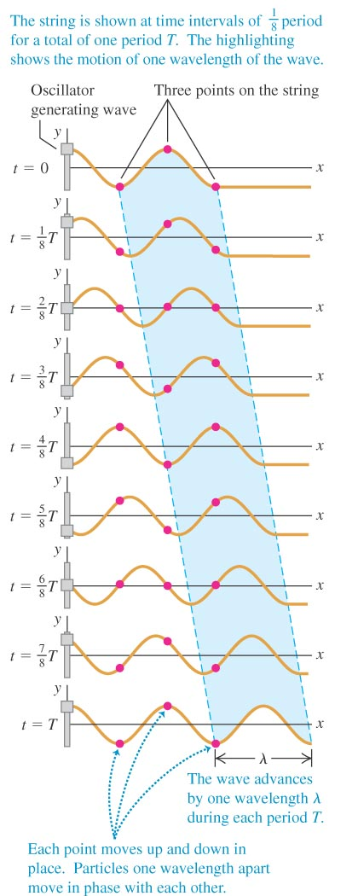
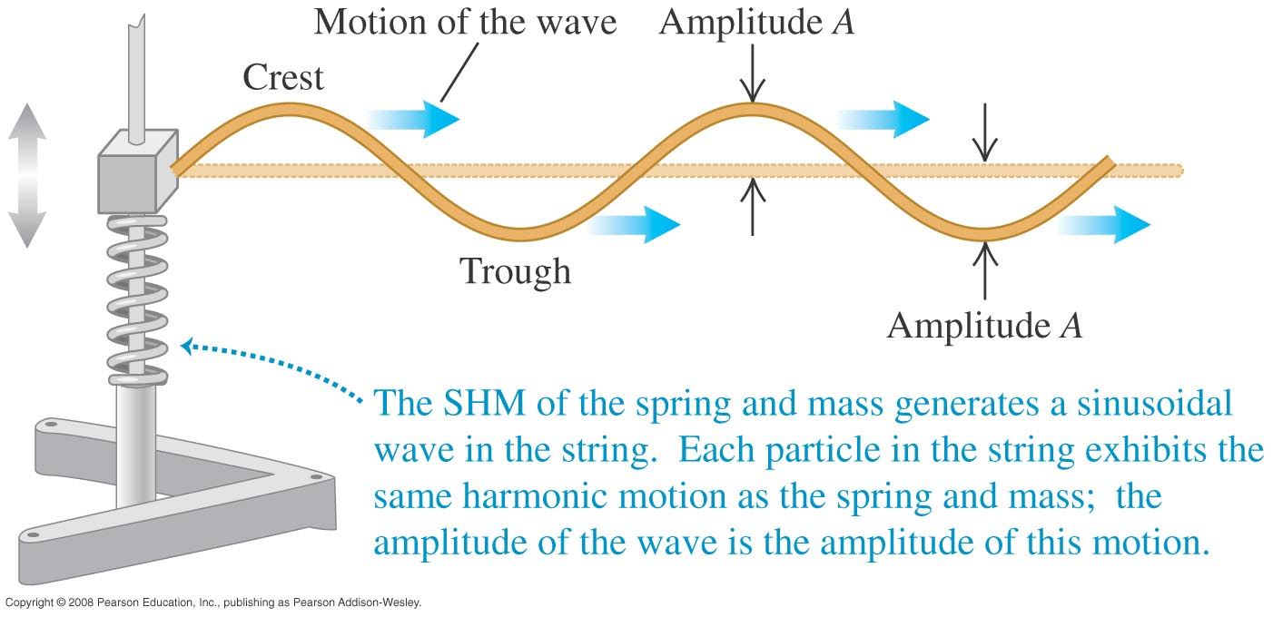
Periodic transverse waves
The mass moves periodically, it generates a periodic pattern that moves to the right. The periodic pattern is the transverse wave pattern
In the string, the particles move up and down, but the transverse wave pattern moves to the right.
The particles do not move to the right or left, just up and down

Slide 7
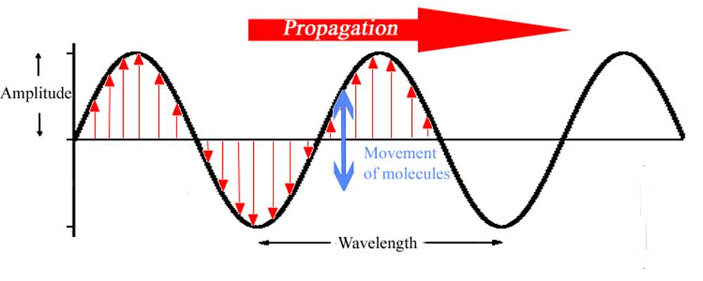
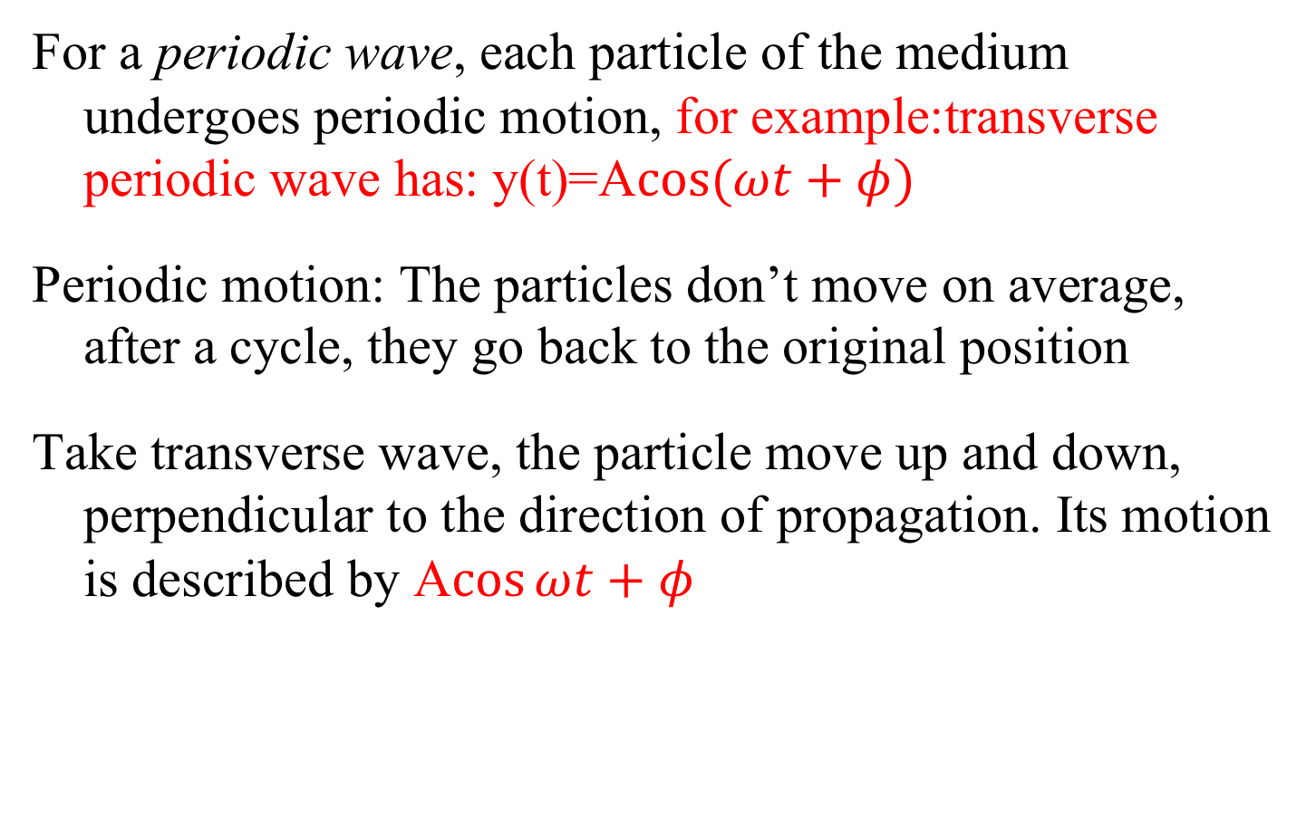
Periodic wave
For a periodic wave, each particle of the medium undergoes periodic motion, for example:transverse periodic wave has: y(t)=A$\cos{(ωt+φ)}$
Periodic motion: The particles don’t move on average, after a cycle, they go back to the original position
Take transverse wave, the particle move up and down, perpendicular to the direction of propagation. Its motion is described by A$\cos{ωt+φ}$
This is periodic pattern in space

Slide 8
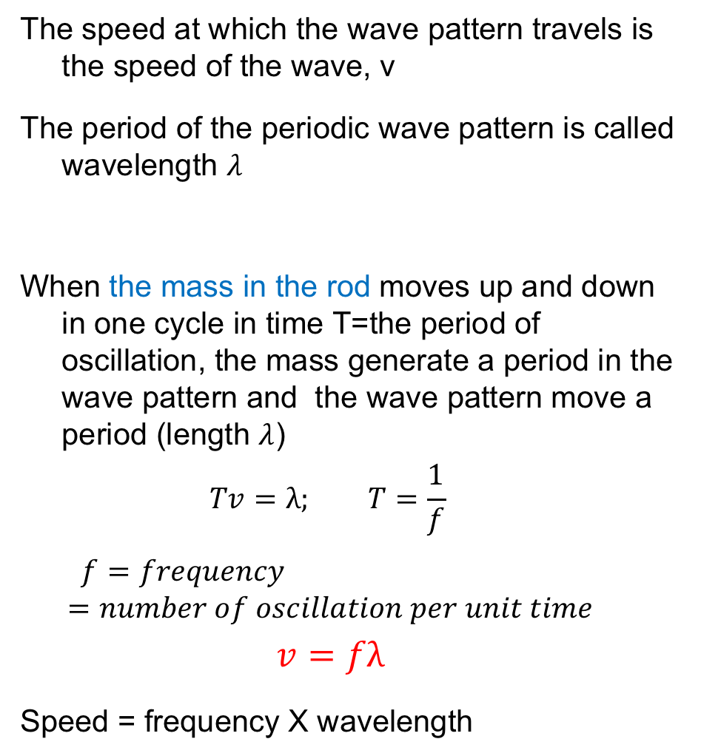
Speed of Wave and wavelength
The speed at which the wave pattern travels is the speed of the wave, v
The period of the periodic wave pattern is called wavelength $λ$
When the mass in the rod moves up and down in one cycle in time T=the period of oscillation, the mass generate a period in the wave pattern and the wave pattern move a period (length $λ$)
$$Tv=λ; T=\frac{1}{f}$$
$$f=frequency =number of oscillation per unit time$$
$$v=fλ$$
Speed = frequency X wavelength
Mass in the rod

Slide 9
Explanation of transverse wave motion
Consider A and B atoms in a string. They are linked together by bonding
A moves up and down in oscillatory motion, with fixed x position, y is changing
A exerts a force on B as they are bonded, so B is moved by A through this force
B also moves up and down in an oscillatory motion, but with a delay from A
A
B
y
x

Slide 10
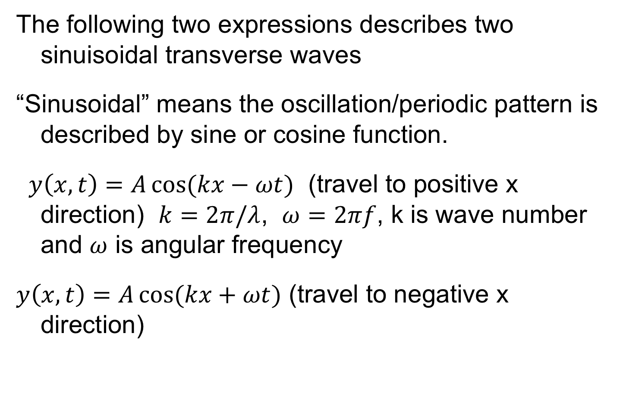
Mathematical expression of a sinuisoidal transverse wave
The following two expressions describes two sinuisoidal transverse waves
“Sinusoidal” means the oscillation/periodic pattern is described by sine or cosine function.
$y\left(x,t\right)=A\cos{(kx−ωt)}$ (travel to positive x direction) $k=2π/λ$, $ω=2πf$, k is wave number and $ω$ is angular frequency
$y\left(x,t\right)=A\cos{(kx+ωt)}$ (travel to negative x direction)

Slide 11
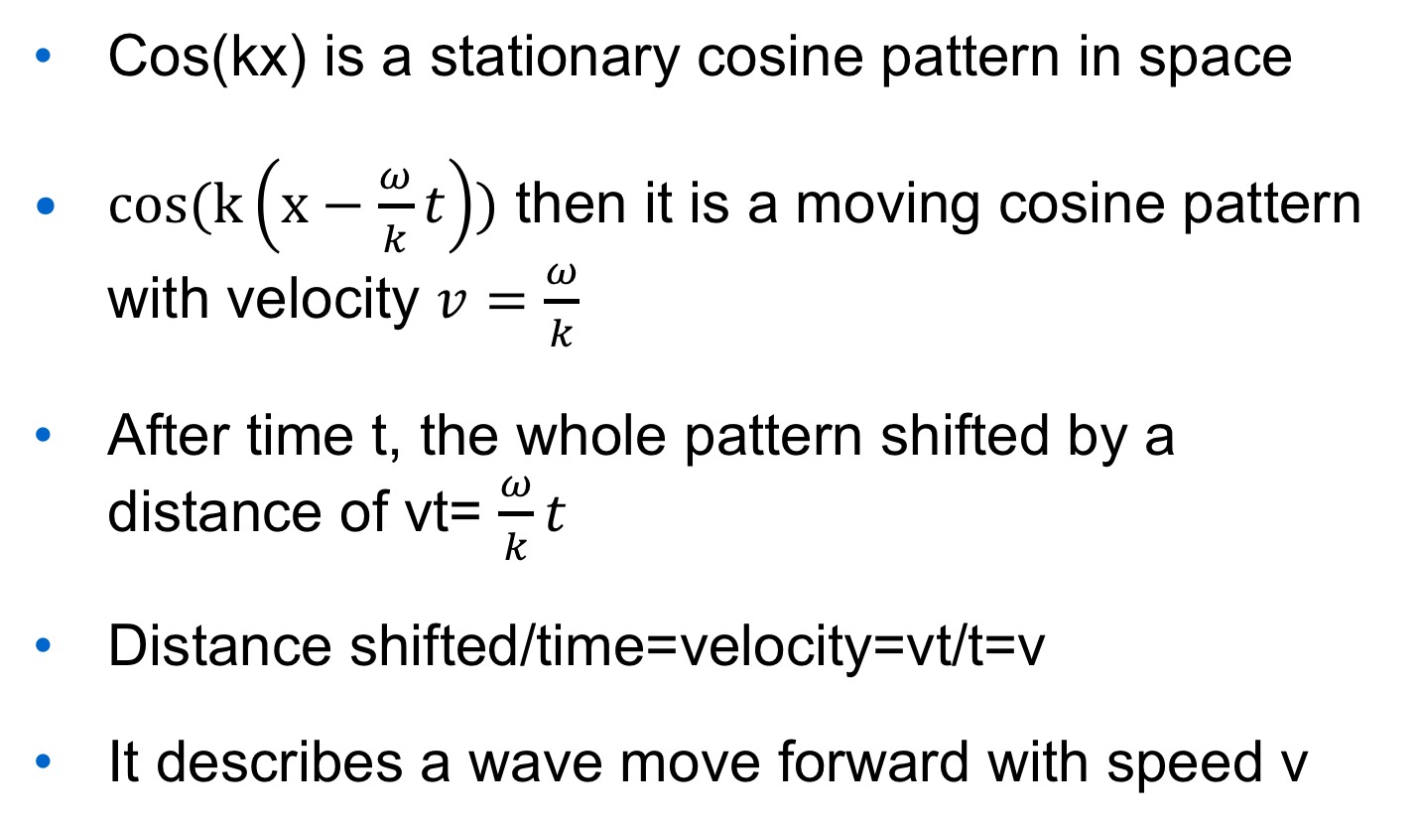
Cos(kx) is a stationary cosine pattern in space
$cos(k\left(x−\frac{ω}{k}t\right))$ then it is a moving cosine pattern with velocity $v=\frac{ω}{k}$
After time t, the whole pattern shifted by a distance of vt= $\frac{ω}{k}t$
Distance shifted/time=velocity=vt/t=v
It describes a wave move forward with speed v

Slide 12
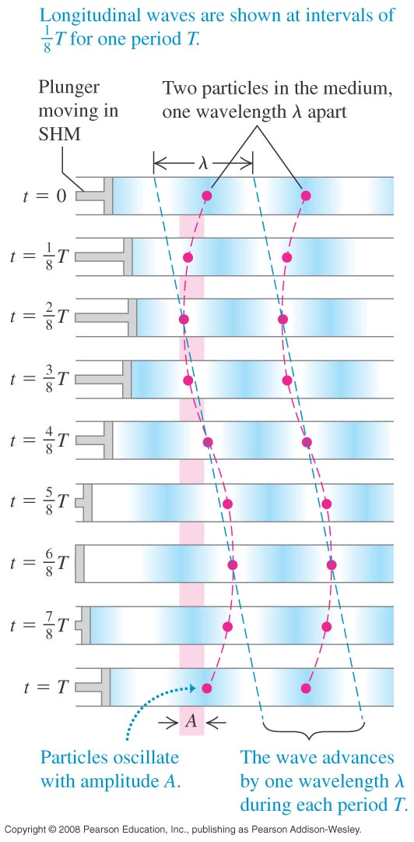
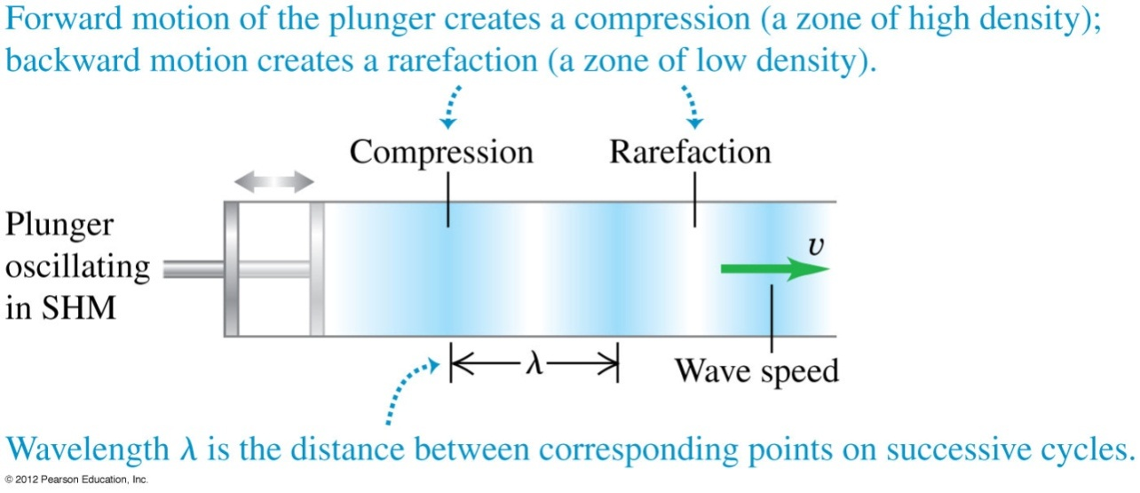
Periodic longitudinal waves
For the longitudinal waves shown here, the particles oscillate back and forth along the same direction that the wave moves.
Gas can be compressed, when molecules move together
Gas is rarefracted when molecules move apart
The wave pattern is a pattern of rarefraction and compresion

Slide 13
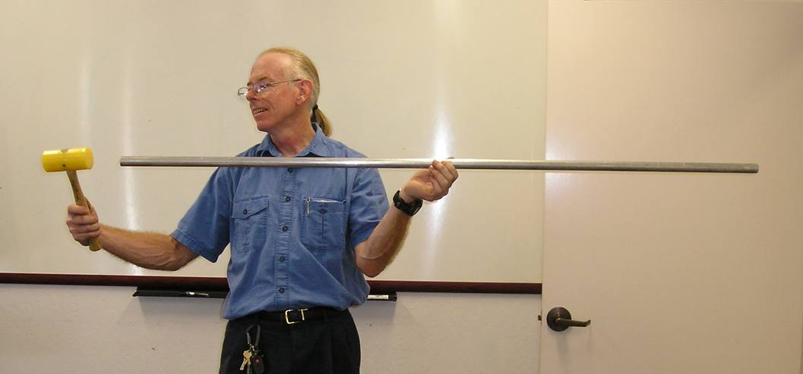
Explanation of longitudinal wave motion
Consider A and B atoms in a rod. They are linked together by bonding
A moves left and right in oscillatory motion, x is changing, average x is fixed. On average A atom does not move
A exerts a force on B as they are bonded, so B is moved by A through this force
B also moves left and right in an oscillatory motion, but with a delay from A, Average position is fixed
A
B
y
x

Slide 14
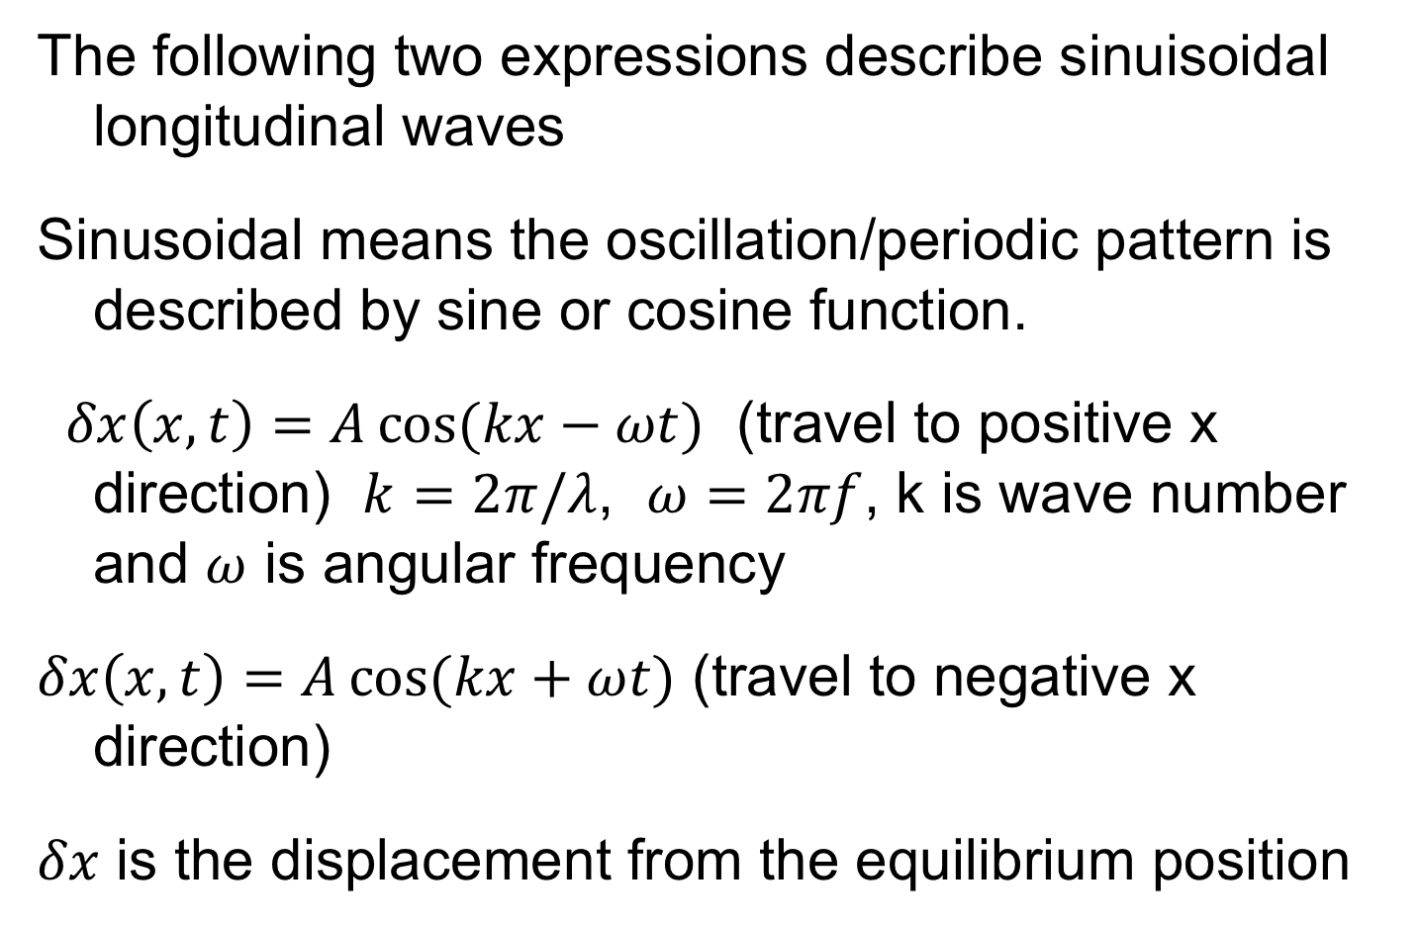
Mathematical expression of a sinuisoidal longitudinal wave
The following two expressions describe sinuisoidal longitudinal waves
Sinusoidal means the oscillation/periodic pattern is described by sine or cosine function.
$δx\left(x,t\right)=A\cos{(kx−ωt)}$ (travel to positive x direction) $k=2π/λ$, $ω=2πf$, k is wave number and $ω$ is angular frequency
$δx\left(x,t\right)=A\cos{(kx+ωt})$ (travel to negative x direction)
$δx$ is the displacement from the equilibrium position

Slide 15
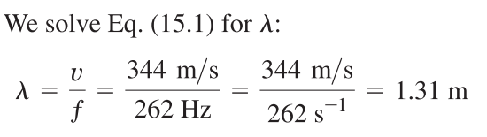
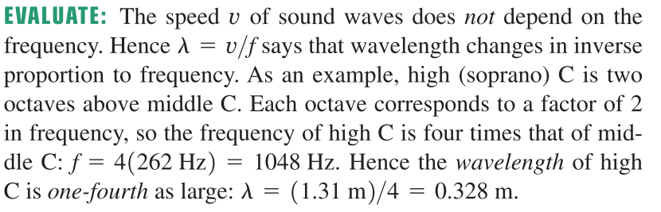
Periodic longitudinal waves
Example 15.1: Wavelength of a musical sound
Sound waves are longitudinal waves in air. The speed of sound
depends on temperature; at 20ºC it is at 344m/s. What is the wavelength of a sound wave in air at 20ºC if the frequency is 262 Hz (the approximate frequency of middle C on a piano)?

Slide 16
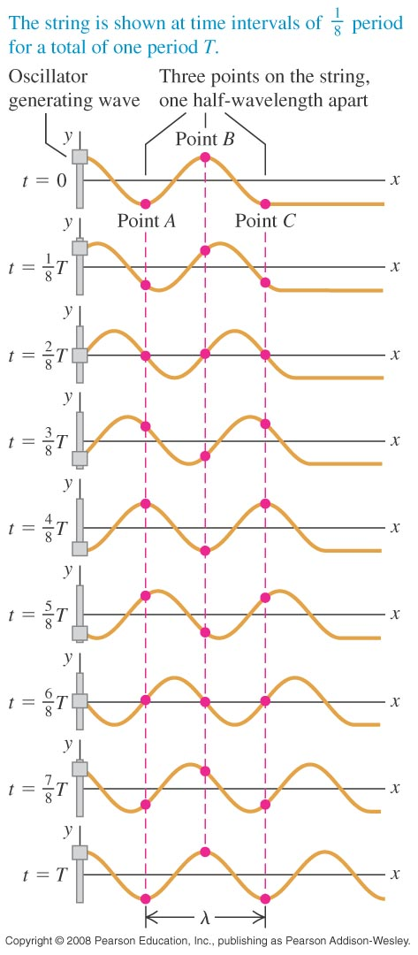
Mathematical description of a wave
The wave function, y(x,t), gives a mathematical description of a wave. In this function, y is the displacement of a particle at time t and position x.
The wave function for a sinusoidal wave moving in the +x-direction is
y(x,t) = Acos(kx – ωt) (15.7)
Other equivalent forms:
where k is called the wave number.

Slide 17
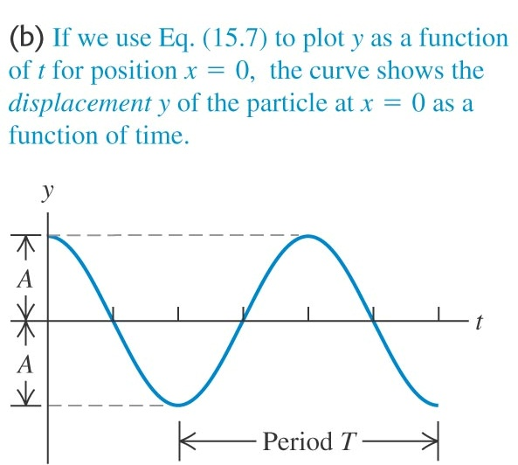
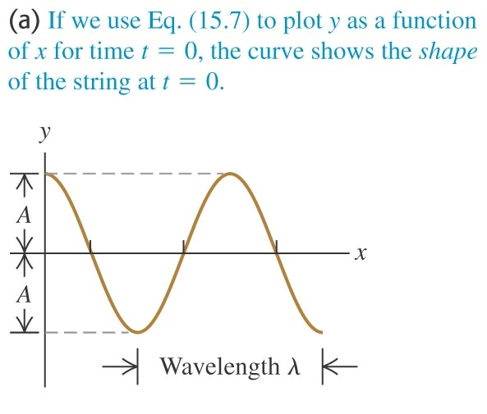
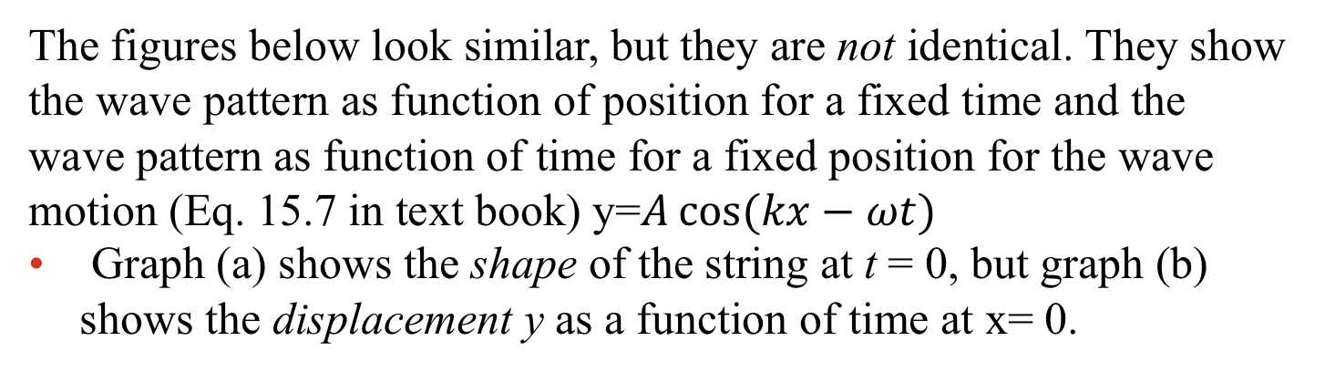
Characteristics of the wave function
The figures below look similar, but they are not identical. They show the wave pattern as function of position for a fixed time and the wave pattern as function of time for a fixed position for the wave motion (Eq. 15.7 in text book) y=$A\cos{(kx−ωt})$
Graph (a) shows the shape of the string at t = 0, but graph (b) shows the displacement y as a function of time at x= 0.

Slide 18
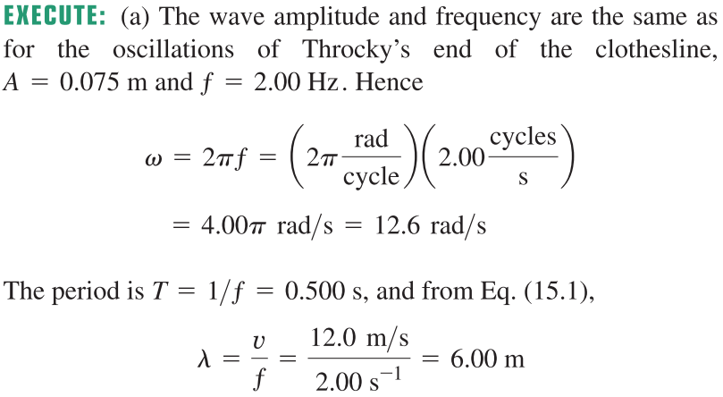
Example 15.2: Wave on a clothesline
Cousin Throckmorton holds one end of the clothesline taut and wiggles it up and down sinusoidally with frequency 2.00 Hz and amplitude 0.075 m. The wave speed on the clothesline is v = 12.0 m/s. At t=0 Throcky’s end has maximum positive displacement and is instantaneously at rest. Assume that no wave bounces back from the far end. (a) Find the wave amplitude A, angular frequency ω, period T, wavelength λ and wave number k. (b) Write a wave function describing the wave. (c) Write equations for the displacement, as a function of time, of Throcky’s end of the clothesline and of a point 3.00 m from that end.
SOLUTION

Slide 19
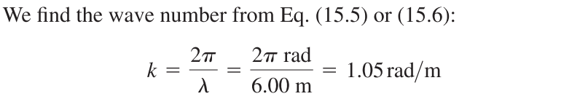
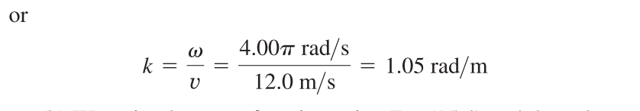
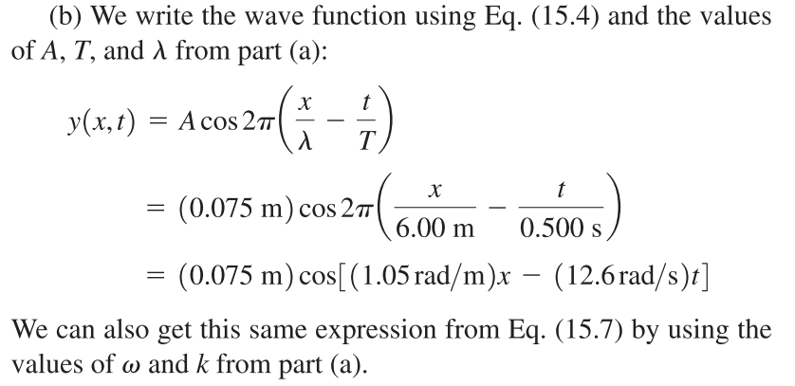
Example 15.2: Wave on a clothesline

Slide 20
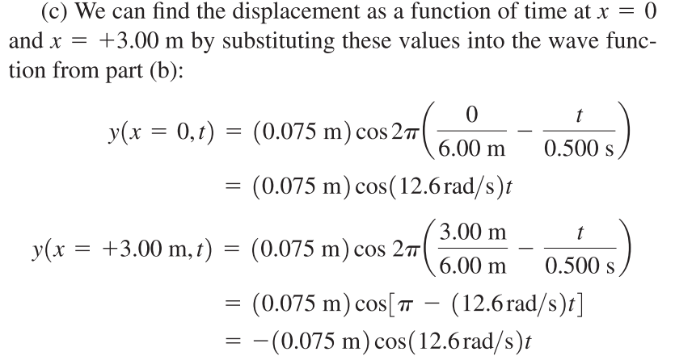
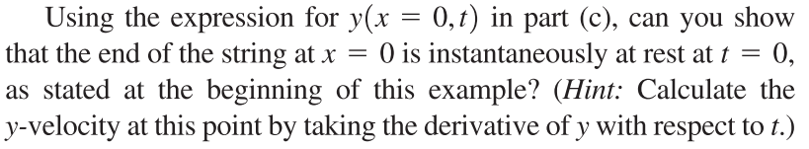
Example 15.2: Wave on a clothesline

Slide 21
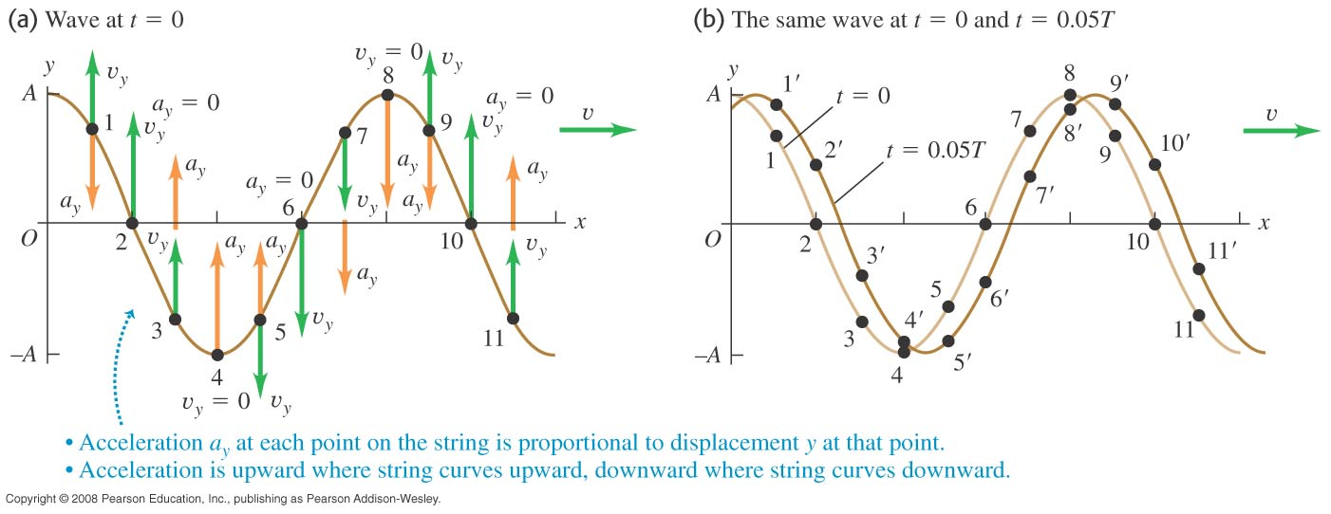
Particle velocity and acceleration in a sinusoidal wave
The graphs below show the velocity and acceleration of particles of a string carrying a transverse wave.
This shows how the pattern looks at two different times. t=0, t=0.05T, which you can use to estimate the velocity and acceleration

Slide 22
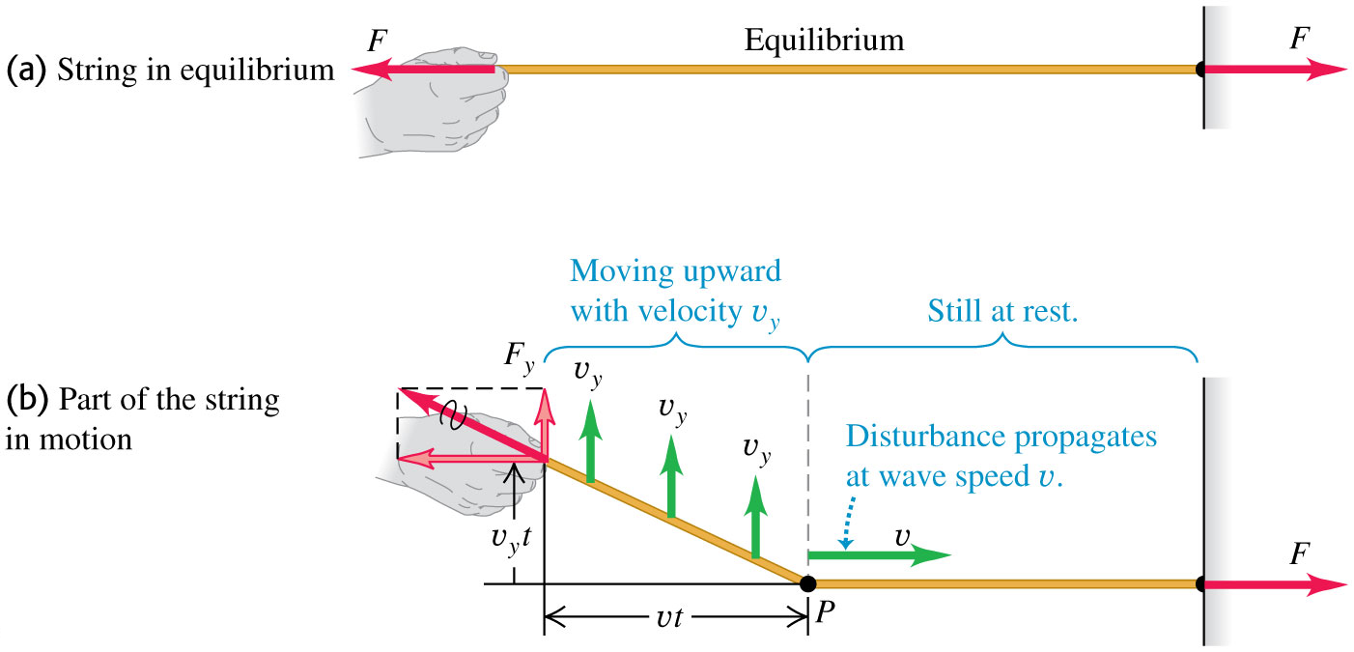
The speed of a wave on a string
Tension in string : F
Linear mass density: μ
The result is
Derivation:
Impulse up to t = change of total transverse momentum in moving portion
F
The resultant of F and F_{y} must be along the directon of the stretched string, because it is a stretched string!

Slide 23
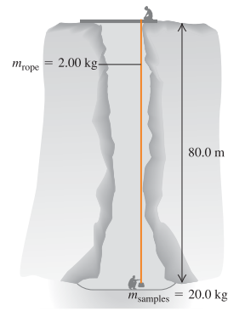
Calculating wave speed
Example 15.3: vertical rope attached to a weight
One end of a 2-kg rope is tied to a support at the top of a mine shaft 80.0 m deep. The rope is stretched taut by a 20 kg box of rocks attached at the bottom.
The geologist at the bottom of the shaft signals to a colleague at the top by jerking the rope sideways. What is the speed of a transverse wave on the rope?
If a point on the rope is in transverse SHM with ƒ = 2.00 Hz, how many cycles of the wave are there in the rope’s length?

Slide 24
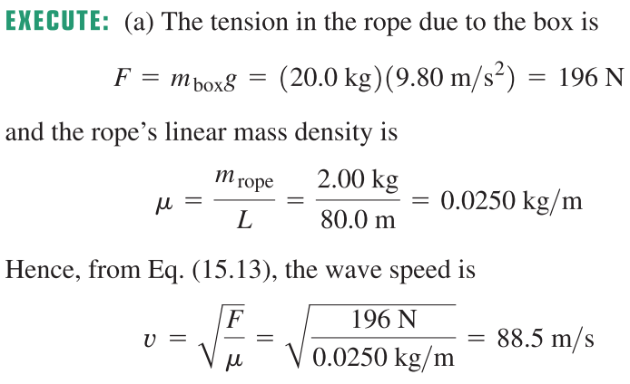
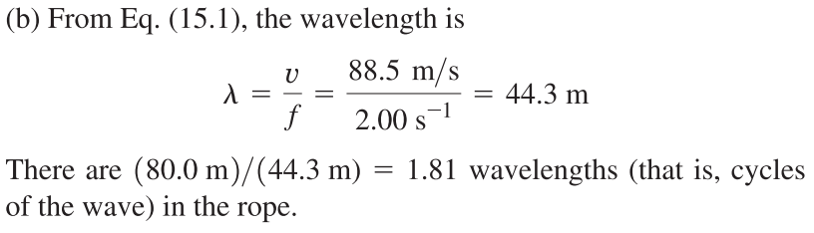
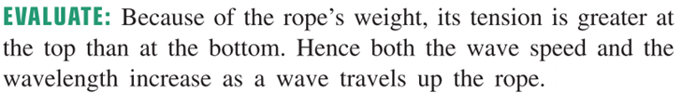
Calculating wave speed
SOLUTION

Slide 25
Energy transfer in a transverse wave
In a transverse wave on a string, particle A moves up and down and exerts force on the neighbouring particle B and causes B to move up and down
The particle A does work on particle B and delivers energy to B. energy is transferred to B from A. B will transfer the energy to another particle next to B
Thus, a transverse wave transfers energy along the string.
Work done=forceX displacement
Power is the rate of transfer of energy
=force X velocity

Slide 26
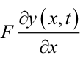
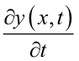
Power of energy transfer in a wave
A wave transfers power along a string because it transfers energy.
The average power is proportional to the square of the amplitude and to the square of the frequency. This result is true for all waves.
F_{y}
v_{y}
Average means average over a cycle

Slide 27
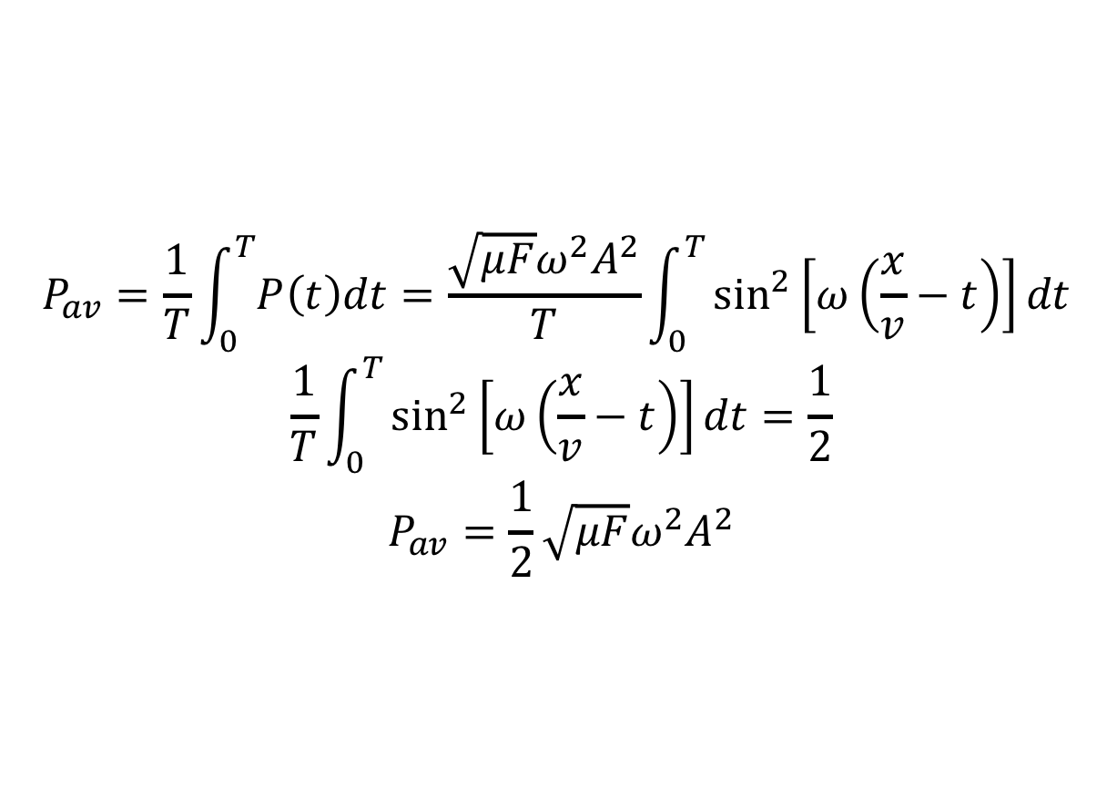
Calculation of average power in a transverse wave
$$P_{av}=\frac{1}{T}\int_{0}^{T}{P\left(t\right)dt}=\frac{\sqrt{μF}ω^{2}A^{2}}{T}\int_{0}^{T}{\sin^{2}\left[ω\left(\frac{x}{v}−t\right)\right]dt }$$
$$\frac{1}{T}\int_{0}^{T}{\sin^{2}\left[ω\left(\frac{x}{v}−t\right)\right]dt=\frac{1}{2}}$$
$$P_{av}=\frac{1}{2}\sqrt{μF}ω^{2}A^{2}$$

Slide 28
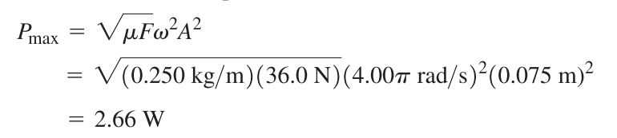
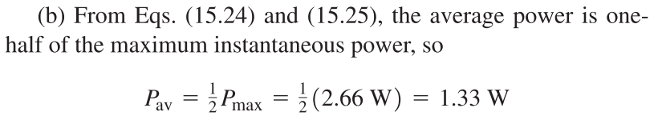
Power in a wave
Example 15.4: Power of the clothesline
In Example 15.2, at what maximum rate does Throcky put energy into the clothesline? That is, what is his maximum instantaneous power? The linear mass density of the clothesline is 0.250kg/m and Throcky applies tension F = 36.0N.
What is his average power?

Slide 29
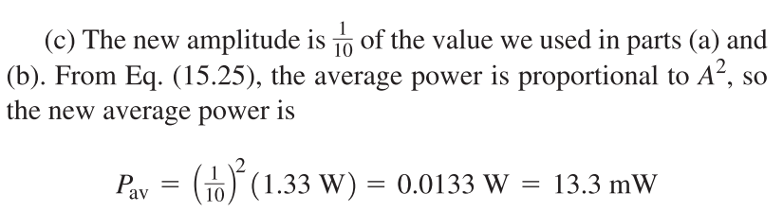
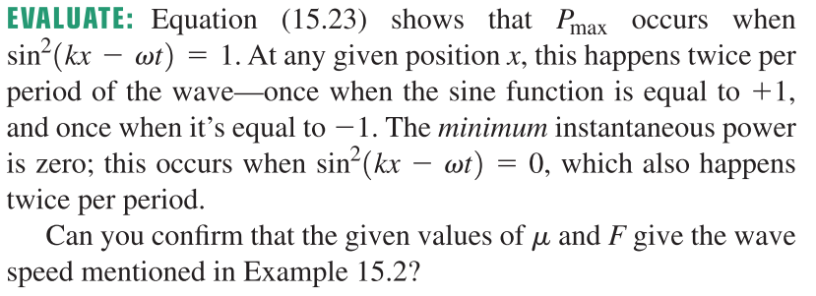
Power in a wave
Example 15.4: Power of the clothesline
(c ) As Throcky tires, the amplitude decreases. What is the average power when the amplitude is 7.50 mm?

Slide 30
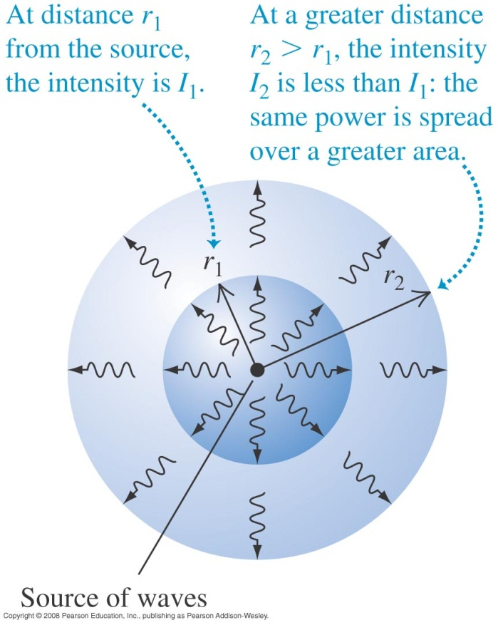
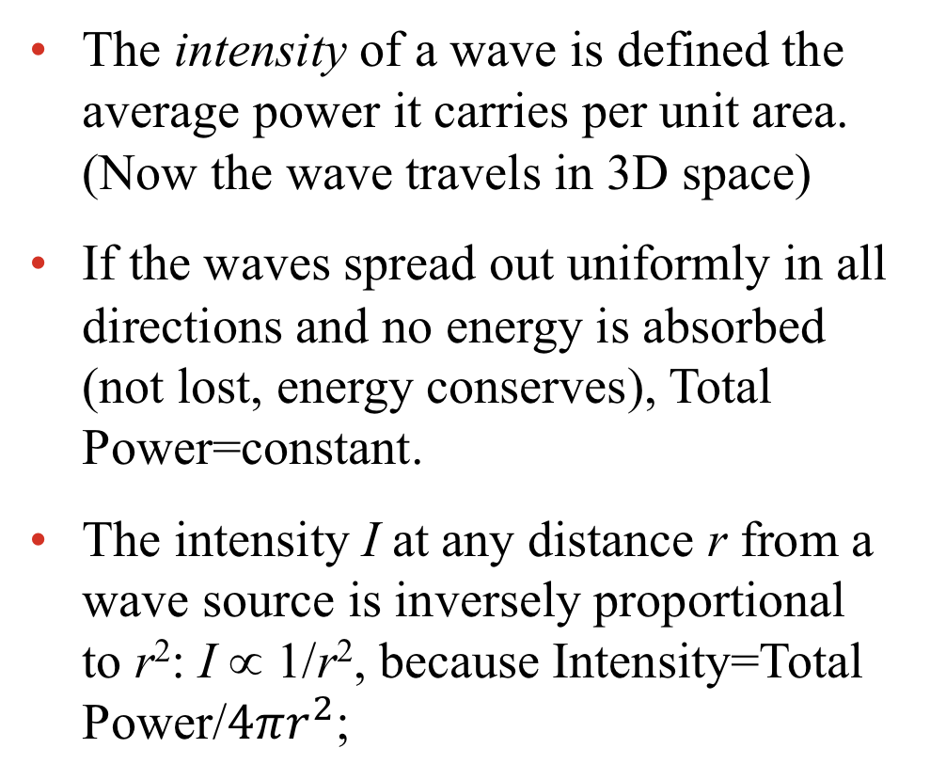
Wave intensity
The intensity of a wave is defined the average power it carries per unit area. (Now the wave travels in 3D space)
If the waves spread out uniformly in all directions and no energy is absorbed (not lost, energy conserves), Total Power=constant.
The intensity I at any distance r from a wave source is inversely proportional to r²: I ∝ 1/r², because Intensity=Total Power/$4πr^{2}$;

Slide 31
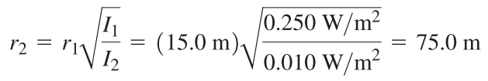
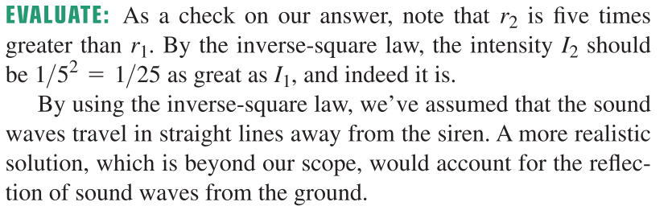
Wave intensity
Example 15.5: The inverse-square law
A siren on a tall pole radiates sound waves uniformly in all directions. At a distance of 15.0 m from the siren, the sound intensity is 0.250 W/m². At what distance is the intensity 0.010 W/m²?

Slide 32
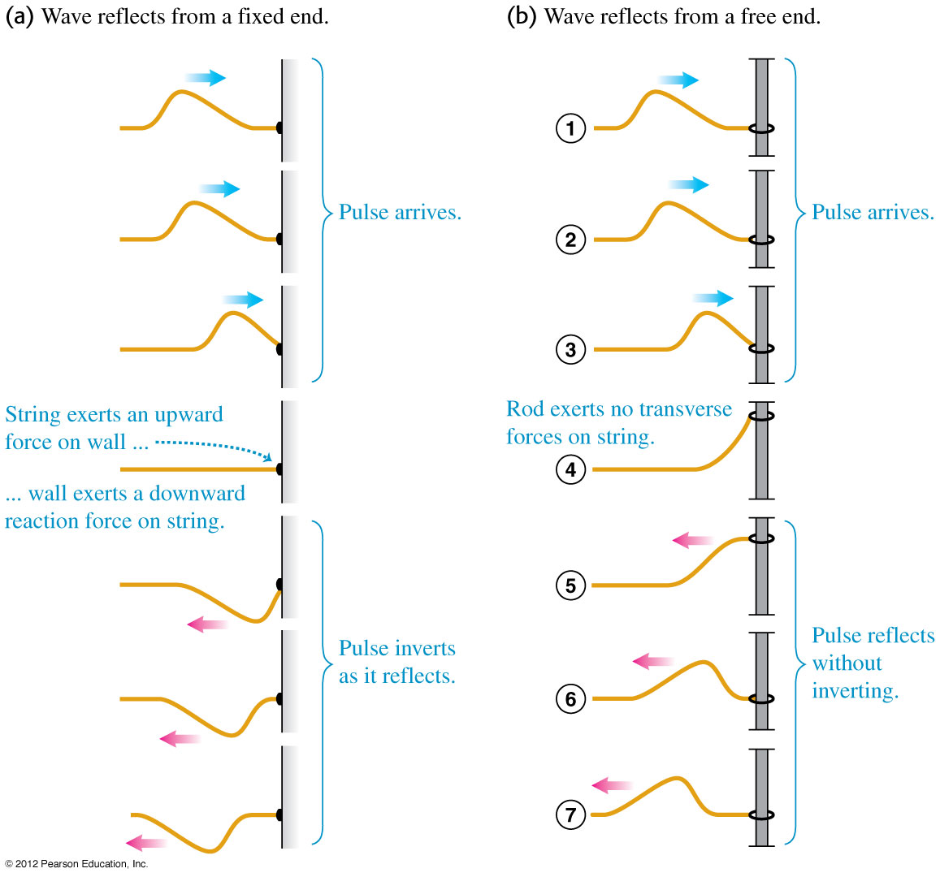
Reflected wave: fixed end
When a Transverse wave reflects from a fixed end, the pulse inverts as it reflects. See figure (a) at the right.
The wave exerts a force on the wall and the wall exerts an equal and opposite force on the string
The wave is the exact reverse of the incident wave, as the force is exactly opposite
Same amplitude but reverse in direction

Slide 33
Reflected wave: free end
When a wave reflects from a free end, the pulse reflects without inverting.
The wave moves the free end up
The free end exerts a force on the string through its weight
This creates a reflected wave
The direction of force is same as direction of force on the string
So the wave reflected back without reverse of motion direction

Slide 34
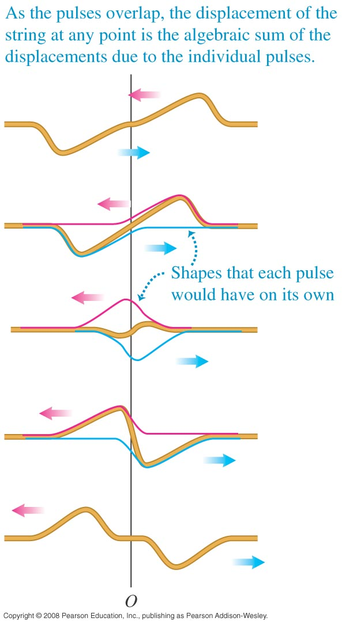
Wave interference and superposition
Interference occurs when two waves overlap.
Principle of super-position: When two or more waves overlap, the total displacement is the sum of the displacements of the individual waves. As a result, the two waves interfere each other
The two waves have opposite displacements. The two displacements cancel (zero) when they are at the same place

Slide 35
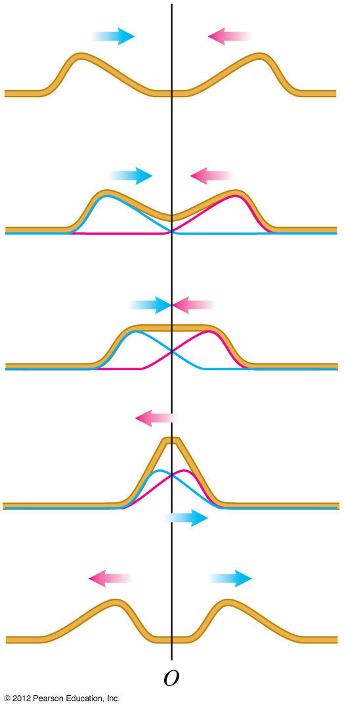
Wave interference and superposition
The two waves have same direction of displacements. The two displacements does not cancel and the resulting displacement is double when they are at the same place

Slide 36

Standing waves on a string
Two waves with same amplitude and same frequency travels in opposite directions on a string interfere with each other and create a standing wave pattern
Standing wave pattern does not move sideway on the string. The pattern moves up and down

Slide 37
standing waves on a string
There are nodes in standing wave where no motion occurs, and the antinodes where the amplitude of the motion is greatest
Destructive interference occurs at the nodes where the wave displacements cancel, and constructive interference occurs at the antinodes, where the displacements add.

Slide 38


The formation of a standing wave
A wave to the left combines with a wave to the right to form a standing wave.

Slide 39


Derivation of the standing wave equation
$$\cos\left(X+Y\right)=\cos{X\cos{Y −\sin{X\sin{Y}}}}$$
$$\cos\left(X−Y\right)=\cos{X\cos{Y+\sin{X}\sin{Y}}}$$
$$−A\cos\left(kx+ωt\right)+\operatorname{Acos}\left(kx−ωt\right)$$
$$=−\operatorname{Acos}\left(kx\right)\cos\left(ωt\right)+\operatorname{Asin}\left(kx\right)\sin\left(ωt\right)$$
$+\operatorname{Acos}\left(kx\right)\cos\left(ωt\right)+\operatorname{Asin}\left(kx\right)\sin{(ωt)}$
=$2A sin\left(kx\right)\sin{(ωt)}$
$\sin\left(ωt\right)$in $2A sin\left(kx\right)\sin{(ωt)}$ means all the particles on the string oscillates
The sin(kx) term means the amplitude of oscillation depends on the position
Standing wave is an oscillation of particles (oscillates up and down) with position dependent amplitude
At x=$\frac{nπ}{k}, n=0,1,2,… \sin\left(kx\right)=0$, the wave has nodes

Slide 40

Positions of nodes and wavelength
Nodes occur at x=$\frac{nπ}{k}=\frac{nπ}{\frac{2π}{λ}}=\frac{nλ}{2}$
From position of nodes, you can find the wavelength of the two waves which forms the standing wave
Then you can find the frequency if you know the wavelength

Slide 41

Normal modes of a string
For a taut string fixed at both ends, the possible wavelengths are λ_{n} = 2L/n and the possible frequencies are f_{n} = n v/2L = nf₁, where n = 1, 2, 3, …
f₁ is the fundamental frequency, f₂ is the second harmonic (first overtone), f₃ is the third harmonic (second overtone), etc.
Figure at right illustrates the first four harmonics.

Slide 42


Standing waves and musical instruments
A stringed instrument is tuned to the correct frequency (pitch) by varying the tension. Longer strings produce bass notes and shorter strings produce treble notes. (See figure below.)

Slide 43

Example 15.6: Standing waves on a guitar string
A guitar string lies along the x-axis when in equilibrium. The end of the string at (the bridge of the guitar) is ﬁxed. A sinusoidal wave with amplitude A = 0.750 mm and frequency f = 440 Hz, corresponding to the red curves in figure in last slide, travels along the string in the x-direction at 143m/s. It is reﬂected from the ﬁxed end, and the superposition of the incident and reﬂected waves forms a standing wave. (a) Find the equation giving the displacement of a point on the string as a function of position and time. (b) Locate the nodes. (c) Find the amplitude of the standing wave and
the maximum transverse velocity and acceleration.
SOLUTION

Slide 44


Example 15.6: Standing waves on a guitar string

Slide 45


Example 15.6: Standing waves on a guitar string

Slide 46


Example 15.7: A giant bass viol
In an attempt to get your name in Guinness World Records, you build a bass viol with strings of length 5.00 m between ﬁxed points. One string, with linear mass density 40g/m is tuned to a 20.0-Hz fundamental frequency (the lowest frequency that the human ear can hear). Calculate (a) the tension of this string, (b) the frequency and wavelength on the string of the second harmonic, and (c) the frequency and wavelength on the string of the second overtone.
SOLUTION

Slide 47


Example 15.8: Waves on a string to sound in air
What are the frequency and wavelength of the sound waves produced in the air when the string in Example 15.7 is vibrating at its fundamental frequency? The speed of sound in air at 20ºC is 334m/s.

Slide 48
TQ8.1
Which of the following wave functions describe a wave that moves in the –x-direction?
A. y(x,t) = A sin (–kx – ωt)
B. y(x,t) = A sin (kx + ωt)
C. y(x,t) = A cos (kx + ωt)
D. both B. and C.
E. all of A., B., and C.
Notes:
Answer: E

Slide 49
TQ8.2
A wave on a string is moving to the right. This graph of y(x, t) versus coordinate x for a specific time t shows the shape of part of the string at that time.
At this time, what is the velocity of a particle of the string at x = b?
y
0
x
b
A. The velocity is upward.
B. The velocity is downward.
C. The velocity is zero.
D. not enough information given to decide
Notes:
Answer: A

Slide 50
TQ8.3
The four strings of a musical instrument are all made of the same material and are under the same tension, but have different thicknesses. Waves travel
A. fastest on the thickest string.
B. fastest on the thinnest string.
C. at the same speed on all strings.
D. not enough information given to decide
Notes:
Answer: B

Slide 51
TQ8.4
While a guitar string is vibrating, you gently touch the midpoint of the string to ensure that the string does not vibrate at that point.
The lowest-frequency standing wave that could be present on the string
A. vibrates at the fundamental frequency.
B. vibrates at twice the fundamental frequency.
C. vibrates at 3 times the fundamental frequency.
D. vibrates at 4 times the fundamental frequency.
E. not enough information given to decide
Notes:
Answer: B

